Slide 1
CREATIVE SECTOR SUMMIT
NWTC
Presented by Bay Area Arts and Culture Alliance
SEPTEMBER 11, 2023

Slide 2
WELCOME Alex Zacarias, co-chair Strategic Assessment Steering Committee Committee Members Kelly Armstrong, GGB Chamber Dennis Buehler, GGB Community Foundation, Co-Chair Kent Hutchison, FAB Collaborative Brian Johnson, On Broadway Jackie Krutz, Titletown Chue Lor-San, artist Jen Metcalf, Downtown Green Bay Gabriel Metoxen, Oneida Nation Chuck Rybak, UW-Green Bay Laura Schley, City of Green Bay Jan Scoville, NWTC Kelli Strickland, Weidner Center Brad Toll, Discover Green Bay Project Manager: Lauren Axell, GGB Chamber
Notes:
ALEX:
Welcome to this Creative Sector Summit following the release of the Strategic Assessment of Greater Green Bay’s Creative Sector.
I am Alex Zacarias, a co-chair of the past Steering Committee for the assessment. You can see the list of Steering Committee members on the screen.
We spent close to a year reviewing and researching the state of our creative sector and how it could develop to better serve the sector itself and the community at large.
We are delighted to have you here and we thank you for accepting our invitation to take these findings to the next step. Your voice is important in shaping the future growth of GGB’s creative sector.
Let me introduce the work group for this summit. (NEXT SLIDE)

Slide 3
INTRODUCTIONS WORK GROUP Carrie Dorski, NWTC Artisan Center Laura Schley, Green Bay Public Art Commission Kelli Strickland, The Weidner at UW – Green Bay and leader of BAACA
Notes:
ALEX:
As many of you know, Kelli Strickland has been very active in this endeavor in her leading role with BAACA. Kelli has been the executive and artistic director of the Weidner Center since 2017 and was the project coordinator for the assessment.
Laura has an Arts Management degree and has been very active in our community’s cultural scene for many years. She has been Public Arts Coordinator for the City of Green Bay since 2017.
Carrie has an Arts Management degree and has been Artisan Center Operations Coordinator at NWTC since 2020.
This will be a three hour, working dinner, summit. There will be two formal breaks but please feel free to take a bathroom break or grab some refreshments at any time.

Slide 4
PURPOSE of THE SUMMIT
Coalition building and long-term cohesiveness of
the GGB creative community
OBJECTIVES
Communicate strategic assessment results
Determine creative sector leadership action agenda
Outline structure of leadership agency
Notes:
ALEX:
The purpose of this summit is to move our sector forward by building a cohesive and long-term coalition dedicated to a collaborative creative strategy. We have been a fragmented creative community for too long and now is our opportunity to make a visible and substantial contribution to the growth and health of Greater Green Bay.
And now, I am turning the presentation over to KELLI STRICKLAND to review the assessment and its results.

Slide 5
REVIEW OF CREATIVE SECTOR ASSESSMENT
Notes:
KELLI:
(I think you can make whatever notes you need, Kelli. I will just point out a few things I think are important. – Christine)
I hope most of you have had a chance to review either the executive summary or the full assessment report before tonight.

Slide 6
STRATEGIC ASSESSMENT OF GREATER GREEN BAY’S CREATIVE SECTOR
A partnership with BAACA, GGB Chamber, and
GGB Community Foundation
GOAL
TO “better harness arts and culture as a powerful tool to help advance multiple community strategic priorities”

Slide 7
PROJECT DESCRIPTION
A deep dive assessment designed to provide the architecture of a longer-term strategic plan for GGB’s creative sector.
GOAL – Harnessing arts and culture as a powerful tool to help advance multiple strategic priorities OBJECTIVES – as identified below
Shared vision and vocabulary for role of arts, culture and creative sector
Identify arts and cultural assets and ways to strengthen and sustain them
HARNESS ARTS & CULTURE
Build on existing plans where creative sector can help accelerate progress
Funding Recommendations

Slide 8
DEFINITION OF PROJECT SCOPE
Non-Profit Arts
Museums, Theaters, Music, Libraries, Botanical Gardens
Creative Businesses/Industry
Ad/pr agencies, tech firms, film companies, florists, jewelry makers, sound/recording companies, radio/ TV stations
Public Assets/Offerings
Zoo, Amusement Parks, Natural Areas, Trails, Bay Beach
The Creative Sector
Artist Entrepreneurs
Individual Creatives
Artists, Musicians, Dancers, Actors, Blacksmiths, Designers, Photographers, Architects (Full or part-time)
Artists, Volunteers, Hobbyists, Crafters, Artisans, Educators, Therapists
Notes:
We added the for profit creative enterprises for the following reasons:
Richard Florida’s book The Creative Class opened up new thinking about the role of creative workers in our communities.
The United Nations continues to report that the “creative economy is one of the world’s fastest-growing sectors. Creative industries create employment and income, promote innovation, and contribute to societies’ well-being”.
We saw potential benefits to GGB in the exploration of all of the creative sector’s assets for three reasons: 1.) the community is very dedicated to innovation and is putting resources behind being an innovative/start-up business and development hub; 2.) creativity is a key component of a sustainable, resilient, and growing community; and 3.) research showed that the community defines arts and creativity in the broadest terms possible, using imagination and a desire for inclusion, unity, entertainment, education, and business growth to lead the way.

Slide 9
ASSESSMENT TASKS
Steering Committee Facilitation
Economic Impact Review
Secondary Community Research
Creative Sector, Business Sector and Community-at-Large Input
Interviews
Town halls
Survey
Government Officials Interviews
Educators Roundtable
Funders Roundtable
Youth Leaders Roundtable
Community Assets Inventory and Mapping
In total, over 1,800 residents of GGB participated in this assessment.

Slide 10
MAIN FINDINGS

Slide 11
CURRENT SECTOR PROFILE
More nationally recognized artists than known, appreciated, or employed
Many artists are more successful selling their art online or out of town
Narrow arts/culture organizational profile – few large organizations over $300K with most under $150K and many under $50K
Wide variety of quality across the sector
No strategic, long-term funding or development strategy from the community for arts and culture
The for-profit creative enterprises are plentiful, varied, highly professional and make a significant contribution to economic and community development of the region
Information collated showed 80+ nonprofit arts and culture organizations, and 225 individual creative businesses, including individual artists.
Notes:
This profile was constructed by the consultants based on their expertise and initial research into the GGB community.

Slide 12
ARTS AND CULTURE SNAPSHOT
Initial results from the Americans for the Arts Arts and Economic Prosperity,6 (AEP 6) are in the table below. Full results are currently scheduled for late Fall/early Winter. BAACA was the lead agency for this study.
You can see that there has been a HUGE increase in number of eligible organizations in the current study. And a significant bounceback on economic impact following COVID.
Nationally, AFTA has seen increased numbers of organizations, reduced attendance, and increased expenditures.
GREATER GREEN BAY RESULTS | Total Number of Eligible Organizations | Number of Participating Organizations | Aggregate EXPENDITURES (participating organizations only) | Aggregate ATTENDANCE (participating organizations only)
AEP5 (FY 2015) | 92 | 41 | $23,392,446 | 378,621
AEP6 (FY 2022) | 137 | 43 | $23,405,059 | 1,033,916
Notes:
KELLI – you should quickly define which types of organizations were included in the study.

Slide 13
CREATIVE ECONOMY SNAPSHOT
The following table provides a snapshot of the economic value generated by Green Bay and Brown County’s creative economies.
Source: Creative Vitality Index 2020
CREATIVE ACTIVITY in 2020 | GREEN BAY zip codes | BROWN COUNTY
Creative Occupations | 1,732 | 3,783
Creative Industry Jobs | 2,772 | 6,471
Creative Industry Sales | $465.5 million | $1.2 billion
Cultural Non-Profits Revenue | $4.7 million | $11.7 million
Notes:
The Creative Vitality Index is a national tool that measures for profit and non-profit creative activity in a community and provides comparison data around the country. An annual subscription to this data will update the information regularly and provide BAACA with national comparables and the opportunity for goal setting benchmarks.
Full details are available in an appendix in the full sector assessment report.

Slide 14
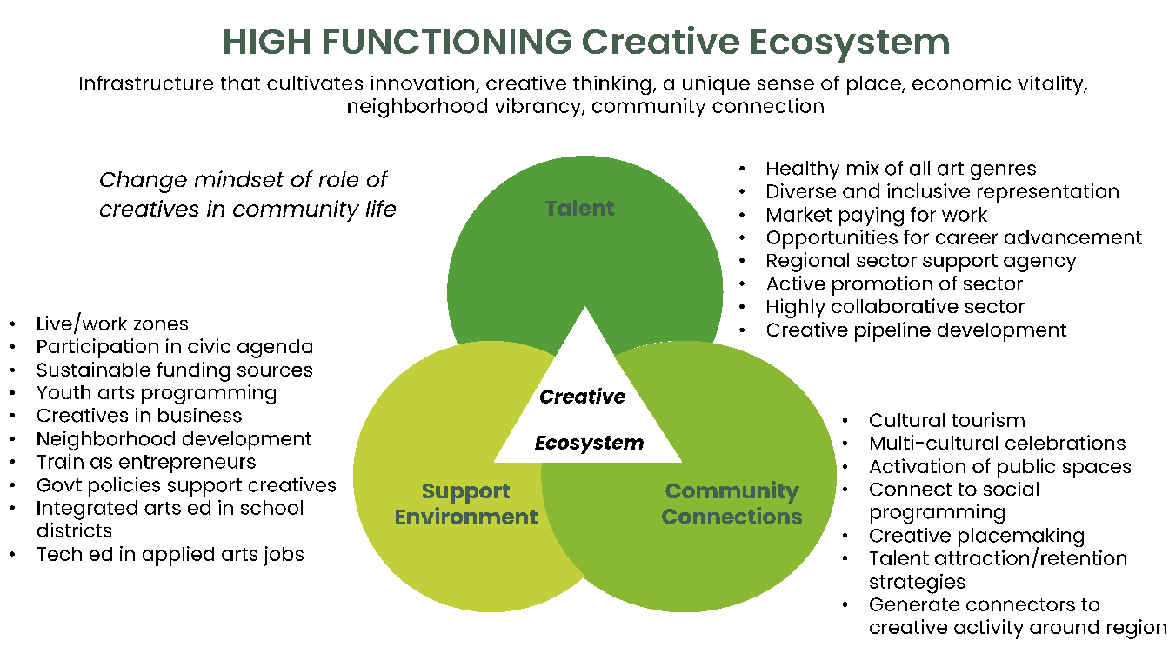
CREATIVE SECTOR ECOSYSTEM

Slide 15
GGB Creative Sector Priorities
Market pay for artist work
More diverse representation
Sustained engagement in civic agenda
More collaboration and public partnerships
Sustained promotion of creatives
Strong, central, united sector agency
Arts education feeder system K-16
Stable gov’t support strategy
Engagement of sector in community development
Broader corporate support
Long term philanthropic strategy for sector support, inc individual artists
Community support for creative sector agency
Funded K-16 strategy for arts education
Cultivate opportunities for mentorships
Expand adult immersive learning
Artist resource directory
WI Creative Economy Coalition
Talent
Business and creative sectors work together to attract/retain talent and bring workers back to offices
Expand neighborhood creative activities for community connection
Advance diversity, inclusion, equity
Develop integrated, multi-modal arts districts
Incorporate creative activity in public and nature spaces
More family-oriented, cross-community activities year round
Creative
Ecosystem
Support
Environment
Community
Connections
Notes:
This is, effectively, the desired GGB Creative Sector Ecosystem.
Make sure you point out the WI Creative Economy Coalition under Support Environment – you aren’t alone!!

Slide 16
FINDINGS: TALENT
Uniting artists will be the absolute first step in growing the sector. The need for a leadership organization.
There is universal agreement that more art is needed by all members of the Green Bay community.
The public’s definition of the arts is extremely broad and focused on commerce, entertainment, and community engagement.
At the same time, the small number of active arts/culture non-profit organizations need continued development to ensure involvement in sector unification and advancement.
Notes:
Uniting artists will be the absolute first step in growing the sector. There is broad agreement among most creatives about the need for a leadership organization.
There is universal agreement that more art is needed by all members of the Green Bay community.
The public’s definition of the arts is extremely broad and focused on commerce, entertainment, and community engagement. Looking at new arts desired, the public desires an integrated mix of year-round and family friendly offerings. This includes everything from visual and performing arts to the healing arts, horse shows, farmers markets to arts districts, more galleries, hands-on demonstrations.
4. At the same time, the small number of active arts/culture non-profit organizations need continued engagement to ensure involvement in sector unification and advancement. The Greater Green Bay community will benefit from a robust non-profit organizational infrastructure as will the future health of the creative sector.

Slide 17
FINDINGS: SUPPORT ENVIRONMENT
There is universal agreement that more art is needed by all members of the Green Bay community.
While many interviewees, focus group and Town Hall participants pointed to a diverse array of funding sources – there was broad agreement that local government can play an active role in supporting the sector.
At this point in time, there is no strategic, cohesive, long-term fund planning for the creative sector.
The business case for arts/cultural expansion is clear and should be made to fit the perspective, information needs, and language of various segments (e.g., public leaders).
Notes:
There is universal agreement that more art is needed by all members of the Green Bay community. However, analysis unveils a profile or typology of art champions. Statistically, they tend to be urban relocators, double income, no kids, 40+. These are the core group that understand both the need for art and the arts resourcing component (i.e., government funding, corporate funding, partnerships, equal pay, jobs/marketing for artists).
While many interviewees, focus group and Town Hall participants pointed to a diverse array of funding sources – there was broad agreement that local government can play an active role in supporting the sector. The survey tested this ideal among a representative population of respondents and found a high average level of agreement (7.91) with the statement that, Government Investment is a Responsible Way to Improve the Quality of Life for All Green Bay Residents.
At this point in time, there is no strategic, cohesive, long-term fund planning for the creative sector.
The business case for arts/cultural expansion is clear and should be made to fit the perspective, information needs, and language of various segments (e.g., public leaders). Green Bay’s corporate executives understand the business appeal of the arts, underscored in their agreement with the top three direct impacts: Strengthen local economy (67% agreement), Attract new workers to GGB (58% agreement), Retain Existing Employees (55% agreement).

Slide 18
FINDINGS: COMMUNITY CONNECTIONS
Green Bay citizens across sectors, ages, and ethnicities place a commonly high value on the arts and creative activities. Building arts for a higher purpose lies in a hierarchy with Quality of Life at the core, fanning outward toward specific purposes and goals (e.g., education, community events, growing local economy, tourism, attracting residents, etc.).
New arts and creative initiatives should focus on the integration of multi-arts activities based in Downtown Green Bay (as well as the Eastern and Western parts of the city). The sector should also focus on initiatives and events that unite arts/culture with local resources (Packers, Oneida, trails, riverfront, UWGB/NWTC).

Slide 19
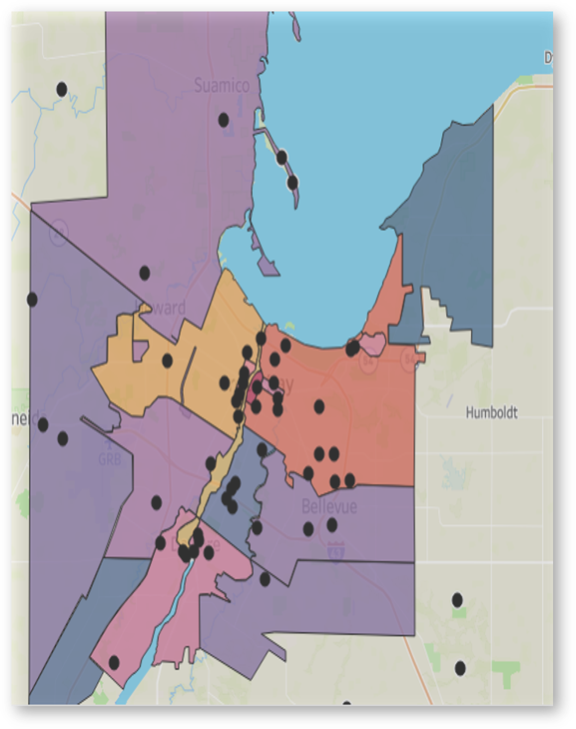
Asset Mapping
Creative Asset Mapping: This is one example of how to use the interactive asset map created in this study. This map shows the desired locations for new arts and culture activities in GGB.
Notes:
KELLI – important to note that this is an interactive tool that is ready to be used and developed by the new leadership agency.

Slide 20
RECOMMENDATIONS

Slide 21
PHASE ONE: COMMUNICATE RESULTS
OBJECTIVE of COMMUNICATION
Develop a shared understanding of the current state and potential of the creative sector with members of the creative sector
Establish shared information about the sector across the community
Increase awareness of the creative sector
Support broad-based community investment in the success of the sector
Notes:
KELLI - make the point that after reflection the order of phases was reversed so that we were communicating not only the assessment results but what the action plan is going forward.

Slide 22
PHASE ONE: COMMUNICATE RESULTS
Conduct Creative Sector Summit
Produce press release with assessment results, what the recommendations mean, and timing of new leadership agency
Host roundtables of key community, corporate and philanthropic leadership
Meet with Mayor and County Executive offices

Slide 23
PHASE TWO: SECTOR LEADERSHIP COALITION
Define creative businesses to be served with agency
Vision and mission statements constructed
Develop GGB High Functioning Creative Ecosystem Model
Establish a strategic plan
Create three year operating budget
Establish fundraising strategy
Announce new leadership agency and structure

Slide 24
QUESTIONS AND ANSWERS

Slide 25
VISION AND MISSION
STATEMENTS

Slide 26
VISION STATEMENT
A CREATIVELY THRIVING GREATER GREEN BAY
Double Meaning:
Fueling a creative and innovative society
Establishing a strong creative sector
What do we want to become?
What is our desired future state?
What inspires passion and commitment to the future?
What will stretch us yet is perceived as achievable?
Notes:
DOCUMENTS with draft Vision and Mission statements at tables
Each table to discuss
Start with Vision and then move to Mission (6’ for each =12)
Identify 3 or 6 important nouns or verbs you think critical to the statement
Different words can be identified than in the statement
No more than 3-6 words per statement; no wordsmithing
Report out from each table – Staff put on flip chart or whiteboard (6’)
If a large crowd, ask for only NEW ideas after the 6th table report
out to save time
Facilitator summarize (2’)

Slide 27
MISSION STATEMENT
TO EXPAND THE CREATIVE CAPACITIES OF BROWN COUNTY THROUGH SUPPORTING, PROMOTING, ADVANCING AND GROWING A COLLABORATIVE ARTS, CULTURE and CREATIVE COMMUNITY
Does this communicate our reason for being?
Express not just what we do but the difference we make?
Does this define our boundaries of service?
Is this a unique mission in Greater Green Bay?
Is this easy to remember and communicate?
Notes:
See Vision details
NOTE: You always want to frame the mission in terms of the impact on the community first.

Slide 28
10 Minutes

Slide 29
DETERMINING AND
ALIGNING PRIORITIES
Notes:
This section is designed to have them work on ordering the priorities set out in the assessment.

Slide 30
CREATIVE SECTOR PRIORITIES
CREATIVE SECTOR PRIORITIES (from Recommendations) | 1st 3 years | 3 years + | Community Priorities #
TALENT: CELEBRATE TALENT…by identifying, promoting, and engaging the multi-faceted talent pool throughout the region to reach its highest potential as creatives and contributors to community life.
QUICK WIN: Build out the asset map to include all individual and organizational creatives and produce a directory of resources. Link creatives with current space occupation.
QUICK WIN: Invite creatives (of all types) onto government and other community committees to be actively engaged in problem solving and advancing the civic agenda more innovatively.
QUICK WIN: Establish a promotional awareness campaign focusing on the range and availability of creative talent in the region – a ‘create locally’ message.
QUICK WIN: Invite creatives of all types and sectors to engage and contribute to the organization of the leadership structure.
Educate the public and the sector about the breadth of talent and broad perceptions of the arts across Greater Green Bay.
Develop a career talent pipeline of resources; education, training, mentorship, entrepreneurship.
Connect creatives to the corporate sector for artists-in-residence, creative activities to draw workers back into offices, art collections in workplaces, etc.
Develop an ‘artists fund’ to sustain and advance broad and deep creative talent.
Support K-16 creative arts educational tracts and continual infusion of arts into the larger curriculum.
Ensure that the leadership coalition places high priority on creative artist development.
Notes:
DOCUMENT Excel Creative Sector Priorities Spreadsheets (note 3 sheets in one
Workbook) on tables
Assign priority order for 1st three years and then Years 3+ (put X in appropriate cell)
Identify one (1) action item under each of the identified 1st three years priorities
-Go back and do this assignment AFTER all priorities are identified
List each 1st three years priorities and their one action item on flip charts
- One page for each ecosystem element (20’)
Report Out (7’)
Facilitator identifies the most common 3 year priorities (watch for some different terminology which may mean the same thing) (3’)
Leave final collated spreadsheet on table for facilitator pick up

Slide 31
CREATIVE SECTOR PRIORITIES
SUPPORT ENVIRONMENT: CULTIVATE SUPPORT ENVIRONMENT…by strategizing, sustaining, and expanding the commitment and mechanisms to ensure the resources required to build sector capacity are structured for the longer term, reviewed regularly, and supported within the sector leadership entity.
QUICK WIN: Establish a creative sector leadership organization.
QUICK WIN: Provide a “creative resources” database that allows open public access to find calendar information, a link to the directory (for hiring creatives), talent recruitment information for Greater Green Bay, future event plans to support building collaborations and partnerships and finding talent.
Rigorously review the range of non-profit arts and culture organizations for gaps in size, quality, type of art, etc. and determine how best to support building a more well-rounded and robust sector.
In addition to incorporating a standalone strategy for the creative sector, integrate arts, culture and creative activities throughout the Greater Green Bay Chamber’s Economic Development Strategic Plan based on assessment findings.
Greater Green Bay Community Foundation host a Creative Sector Philanthropic Summit (including venture capital investors) to review assessment results and discuss short and longer-term investment needs – exploring potential range of funding mechanism from a community united arts fund to investment capital
Greater Green Bay Chamber and City of Green Bay host a Creative Sector Development Summit, in partnership with new leadership coalition, to review assessment findings, and economic impact studies to establish a strategy for elevating awareness of the creative sector as a strong and active participant in regional development.
Establish a ‘creative education task force’ to review current K-16 creative curriculum and career opportunities to establish a strategy of expanding commitment and resources to build and support a creative talent pipeline (including technical arts employment and arts administration) of exposure, education, mentorship and career development.
City of Green Bay and Brown County discuss assessment findings with their departments and strategize how to easily access creatives for decision-making and support the creative sector agenda within government planning.
Generate partnership with Wisconsin Creative Economy Coalition to form alignment with strategic planning for the creative sector.
Notes:
See notes on previous slide

Slide 32
CREATIVE SECTOR PRIORITIES
COMMUNITY CONNECTIONS: INTEGRATE COMMUNITY CONNECTIONS…by including, collaborating, and activating activities across the region that develop partnerships and activities designed to deepen resident inclusion, access, celebration, engagement, and civic pride.
QUICK WIN: Integrate more creative activities into community events to raise awareness, directly market artists and showcase talent and creative options available.
Provide access to a wider array of integrated creative activities year-round.
Develop partnerships with local businesses, neighborhood associations and cultural associations to build a creative agenda together with the sector’s leadership entity.
Strategize and develop integrated arts districts across the region – opportunity to build connection across a community divided by water and railroad tracks.
Involve creative sector leadership entity when planning neighborhood development.
Utilize the creative sector asset map to include neighborhood organizations, festivals, and events – identify gaps and opportunities to bring together individuals of diverse backgrounds, cultures and belief systems.
City to develop an artist live/workspace program.
Notes:
See notes on previous slide

Slide 33
COMMUNITY PRIORITIES
 | COMMUNITY PRIORITIES (as generated by the City, Chamber, LIFE Study)
A | place-based creative activities
B | space activation
C | public art
D | local tourism
E | economic enhancement
F | quality of life
G | community seeking inclusion and more diverse opportunities
H | building a strong local identity rich in arts, culture and engaging creative activities
J | attracting and retaining talent
K | increasing neighborhood connections
L | accelerate downtown and urban development
M | ecosystem for innovation and entrepreneurship
Notes:
There will be copies of these spreadsheets at each table.
DOCUMENT Community Priorities Spreadsheet
Using same spreadsheet from above exercise
Put letter of each community priority next to relevant creative sector priority (7’)
Are all priorities represented (don’t need to be but there should be a majority)
Report Out: What are the dominant common, or aligned, priorities (5’)

Slide 34
DESIRED OUTCOMES
5 yrs from now US NEWS & WORLD REPORT reporter visits Green Bay; heard there is a fabulous creative community here that has given Green Bay international recognition.
Asks: Describe how GGB looks and feels in 2028 as a result of the input of the creative sector. (e.g. List the ways GGB changed in these past 5 years.)
Notes:
5 yrs from now US NEWS & WORLD REPORT reporter visits Green Bay; heard there is a fabulous creative community here that has given Green Bay international recognition REFERENCE THE LAST RANKING FROM US NEWS????
Asks: Describe how GGB looks and feels in 2028 as a result of the input of the creative sector. (e.g. List the ways GGB changed in these past 5 years.) (20’)
Small table report outs (again, if a large crowd, only NEW ideas after the 6th report out) (10’)
Facilitator summarizes changes (with ecosystem component?) (5’)

Slide 35
BREAK (10
10 Minutes

Slide 36
LEADERSHIP STRUCTURE
We are going to assume we move forward with BAACA
1) Who does BAACA serve? Direct or indirect (e.g. members or allies)
Nonprofit arts and culture
Independent artists
For profit creative enterprises
2)What representation needs to be on the Board?
Notes:
We are going to assume we move forward with BAACA
Small group discussions (15’)
Who does BAACA serve? Direct or indirect (e.g. members or allies)
Nonprofit arts and culture
Independent artists
For profit creative enterprises – integrated or an alliance
What representation needs to be on the Board
Report outs (10’)
Facilitator identifies commonalities/themes

Slide 37
MEASURES OF SUCCESS
There is a sector leadership entity
Strong coalition advocates for engagement of culture
There is a funding mechanism that is robust and accessible
The philanthropic community embraces its value through annual support for a sector leadership.
We have a unified definition and vision for creative sector
The broader public rallies behind a unified definition of the arts and the impact the arts have on everyone’s quality of life
We have a thriving, interactive map of the arts (including a database of artists in the community)
Arts and culture is inclusive and broadly understood enough to expand understanding of ROI and all members of the sector have an equal voice
Artists in all disciplines are pursuing arts opportunities and careers in Greater Green Bay
We have a thriving, interactive and comprehensive calendar of arts events
There are initiatives/events etc. that fill creative needs locally
Artists, creatives, makers actively move here for thriving creative job opportunities
Businesses understand value of arts/creatives and actively invest to continue improvement of the sector
There is healthy collaboration between individual artists and arts-based groups
Notes:
These were developed by the Steering Committee
Scale of 1-5: how strongly do you agree with these measures? Would you add any others?
1 = strongly disagree, 2 = disagree, 3 = neutral, 4 = agree, 5 = strongly agree
See DOCUMENT

Slide 38
NEXT STEPS

Slide 39
THANK YOU!
For further information, please contact:

